Slide 1

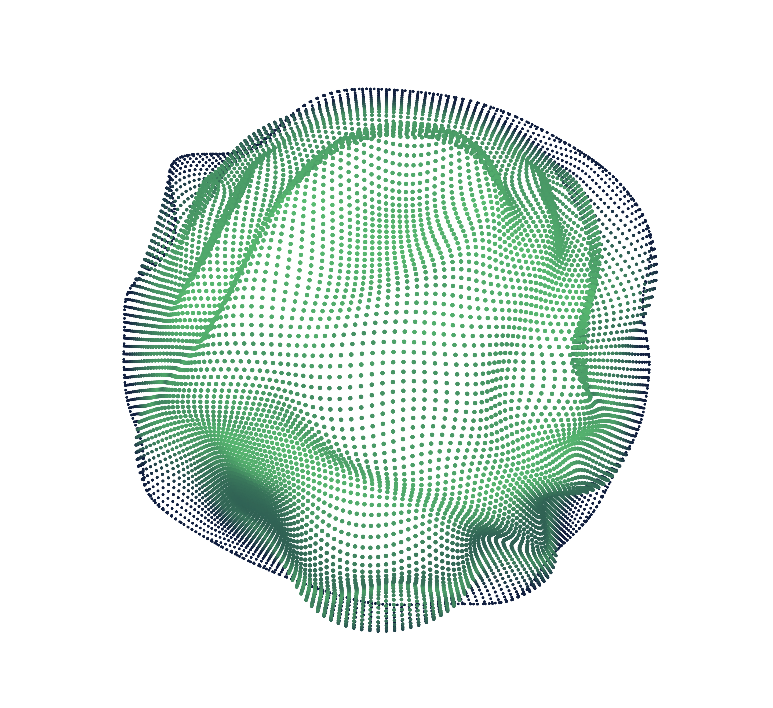

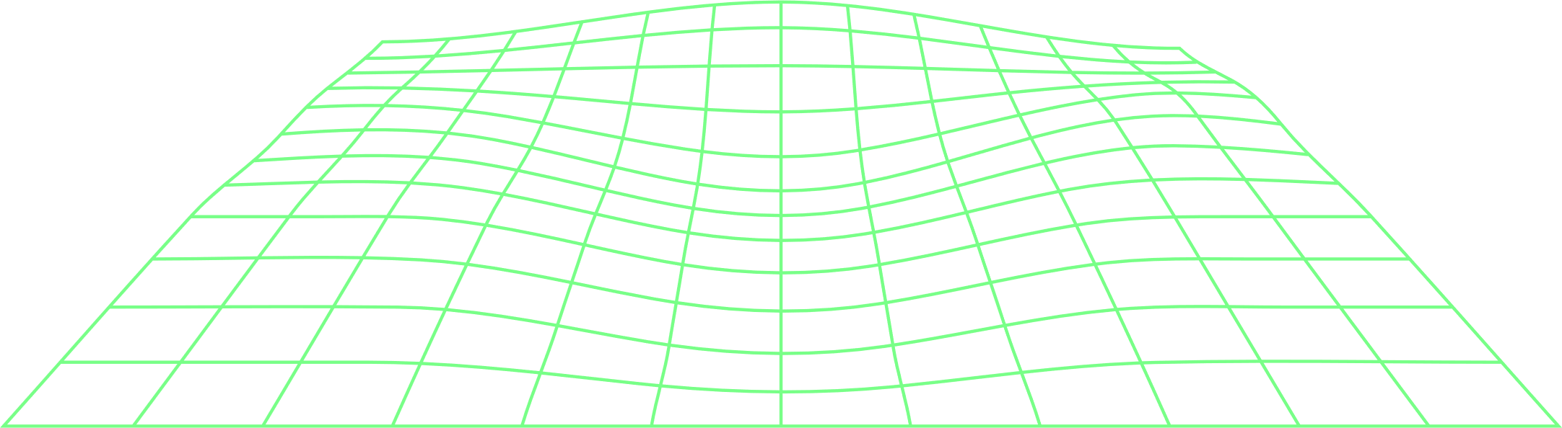
NEURAL NETWORKS
BY: CATHERINE KANINI

Slide 2
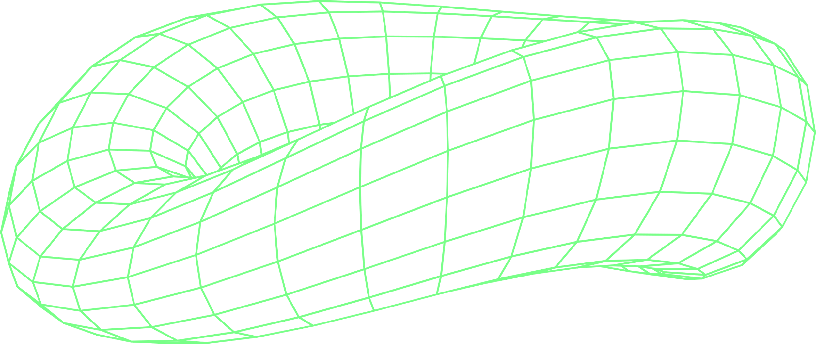
CONTENT
O
O
1
What is a neural network?
4
How do neural networks work?
O
O
2
Why are neural networks important?
5
What are the Limitations of Neural Networks?
O
O
3
What are neural networks used for?
6
Types of Neural Networks

Slide 3

Introduction
What is a neural network?
A neural network is a machine learning program, or model, that makes decisions in a manner similar to the human brain, by using processes that mimic the way biological neurons work together to identify phenomena, weigh options and arrive at conclusions.

Slide 4
Introduction cont…
Every neural network consists of layers of nodes or artificial neurons, an input layer, one or more hidden layers, and an output layer.
Each node connects to others, and has its own associated weight and threshold. If the output of any individual node is above the specified threshold value, that node is activated, sending data to the next layer of the network. Otherwise, no data is passed along to the next layer of the network.
Neural networks rely on training data to learn and improve their accuracy over time. Once they are fine-tuned for accuracy, they are powerful tools in computer science and artificial intelligence, allowing us to classify and cluster data at a high velocity.
Tasks in speech recognition or image recognition can take minutes versus hours when compared to the manual identification by human experts. One of the best-known examples of a neural network is Google’s search algorithm.

Slide 5
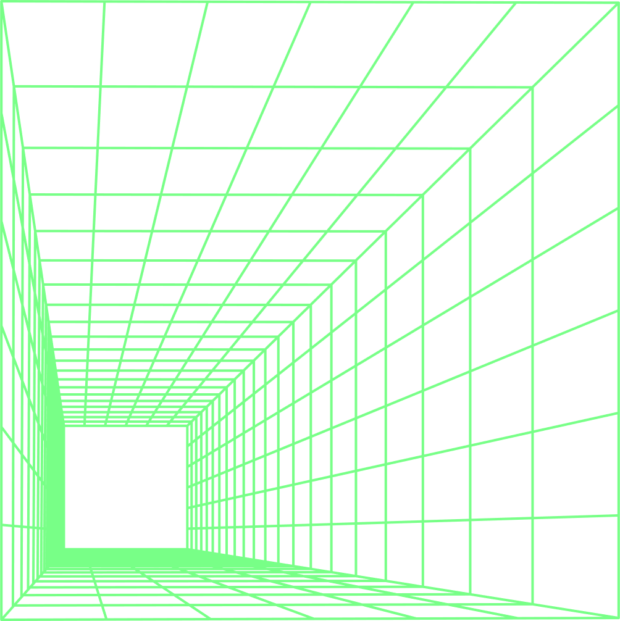
Why are neural networks important?
Neural networks have several use cases across many industries, such as the following:
Medical diagnosis by medical image classification
Targeted marketing by social network filtering and behavioral data analysis
Financial predictions by processing historical data of financial instruments
Electrical load and energy demand forecasting
Process and quality control
Chemical compound identification

Slide 6
What are neural networks used for?
1. Computer Vision
Computer vision is the ability of computers to extract information and insights from images and videos. With neural networks, computers can distinguish and recognize images similar to humans. Computer vision has several applications, such as the following:
Visual recognition in self-driving cars so they can recognize road signs and other road users
Content moderation to automatically remove unsafe or inappropriate content from image and video archives
Facial recognition to identify faces and recognize attributes like open eyes, glasses, and facial hair
Image labeling to identify brand logos, clothing, safety gear, and other image details

Slide 7
Cont…
2. Speech Recognition
Neural networks can analyze human speech despite varying speech patterns, pitch, tone, language, and accent. Virtual assistants like Amazon Alexa and automatic transcription software use speech recognition to do tasks like these:
Assist call center agents and automatically classify calls
Convert clinical conversations into documentation in real time
Accurately subtitle videos and meeting recordings for wider content reach

Slide 8
Cont…
3. Natural Language Processing
Natural language processing (NLP) is the ability to process natural, human-created text. Neural networks help computers gather insights and meaning from text data and documents. NLP has several use cases, including in these functions:
Automated virtual agents and chatbots
Automatic organization and classification of written data
Business intelligence analysis of long-form documents like emails and forms
Indexing of key phrases that indicate sentiment, like positive and negative comments on social media
Document summarization and article generation for a given topic

Slide 9
Cont…
4. Recommendation Engines
Neural networks can track user activity to develop personalized recommendations. They can also analyze all user behavior and discover new products or services that interest a specific user.
For example, Curalate, a Philadelphia-based startup, helps brands convert social media posts into sales. Brands use Curalate’s intelligent product tagging (IPT) service to automate the collection and curation of user-generated social content.
IPT uses neural networks to automatically find and recommend products relevant to the user’s social media activity.
Consumers don't have to hunt through online catalogs to find a specific product from a social media image. Instead, they can use Curalate’s auto product tagging to purchase the product with ease.

Slide 10
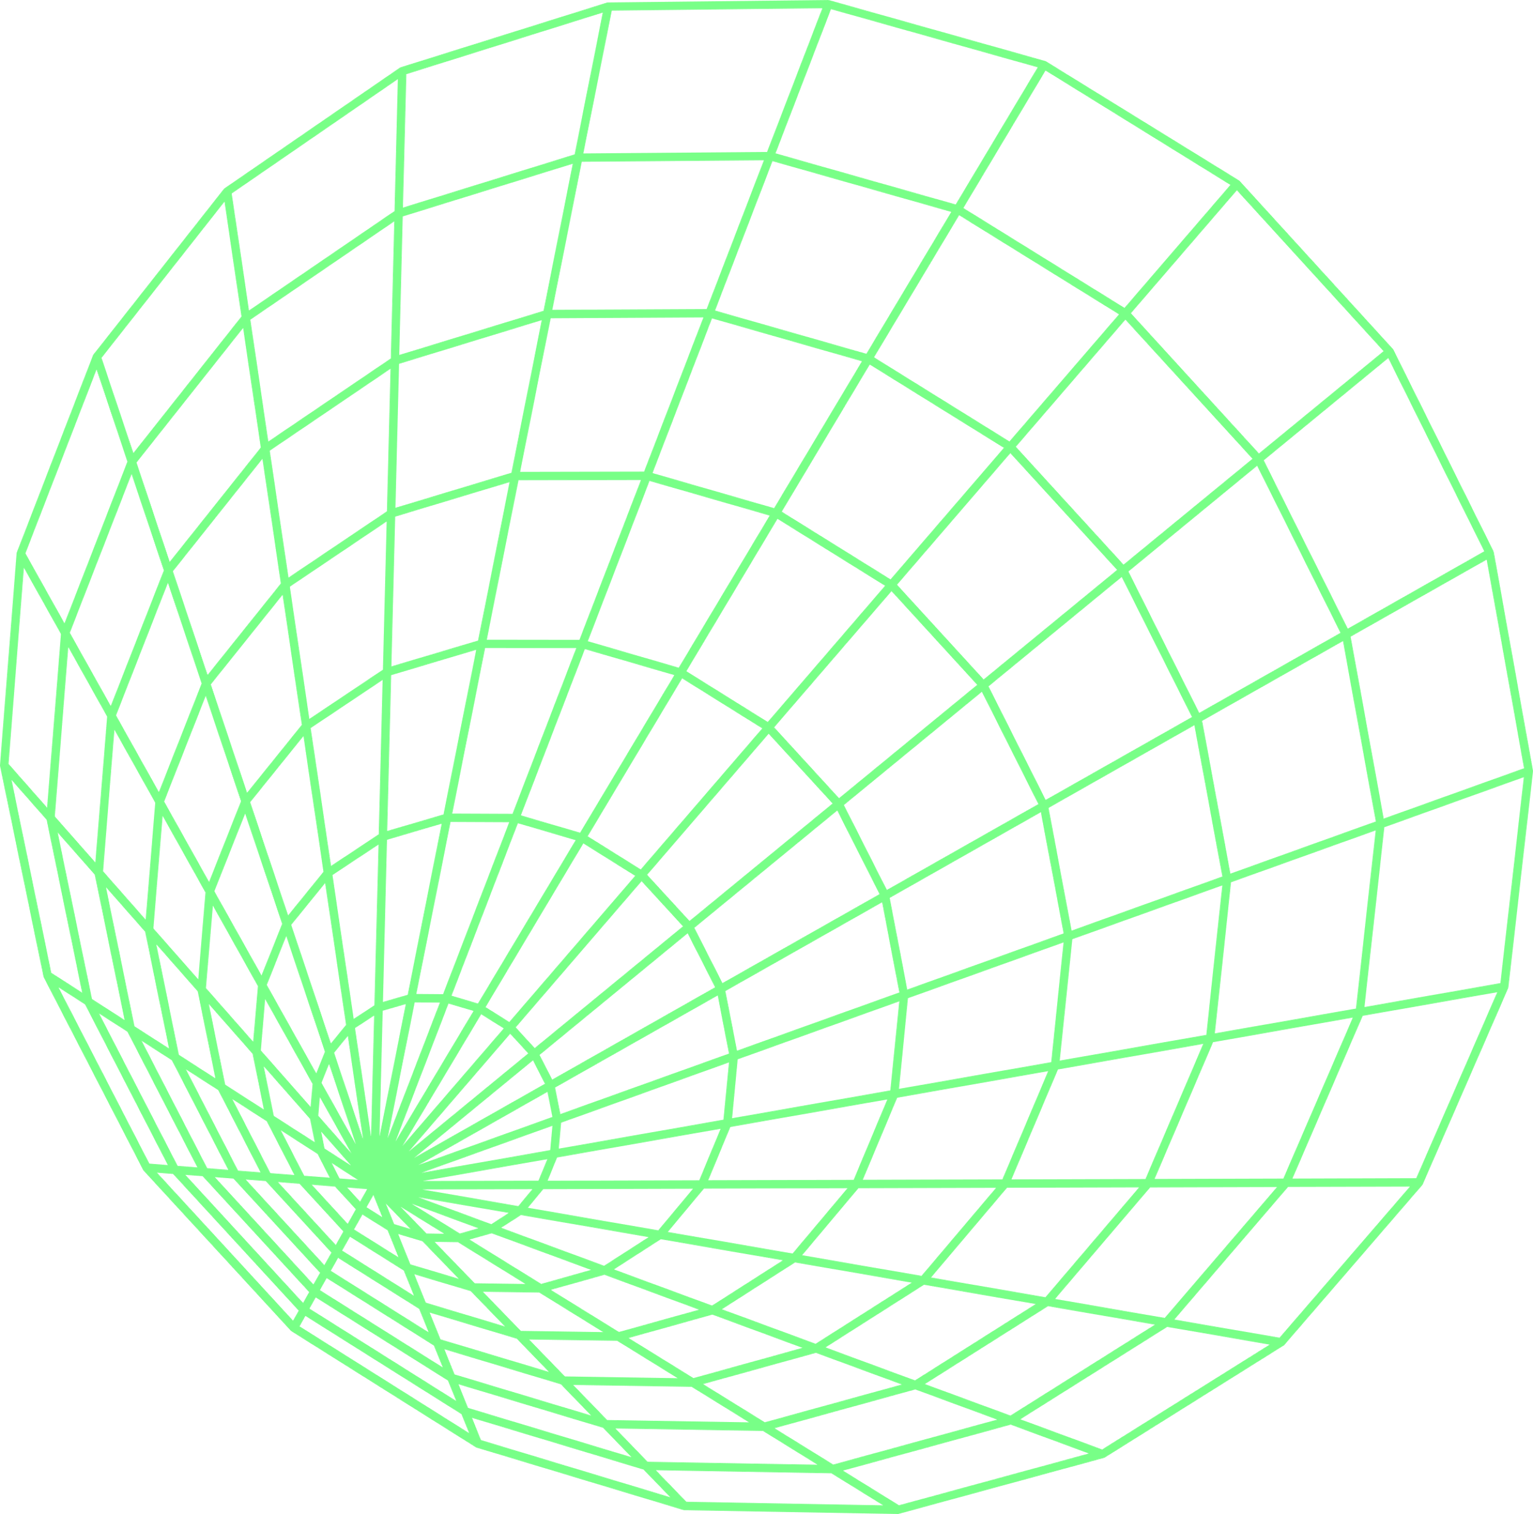
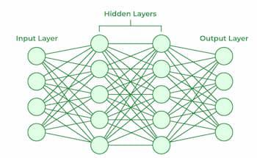
Cont…
Layers in Neural Network Architecture
Input Layer: This is where the network receives its input data. Each input neuron in the layer corresponds to a feature in the input data.
Hidden Layers: These layers perform most of the computational heavy lifting. A neural network can have one or multiple hidden layers. Each layer consists of units (neurons) that transform the inputs into something that the output layer can use.
Output Layer: The final layer produces the output of the model. The format of these outputs varies depending on the specific task like classification, regression.

Slide 11
Cont…
Neural networks are capable of learning and identifying patterns directly from data without pre-defined rules. These networks are built from several key components:
Neurons: The basic units that receive inputs, each neuron is governed by a threshold and an activation function.
Connections: Links between neurons that carry information, regulated by weights and biases.
Weights and Biases: These parameters determine the strength and influence of connections.
Propagation Functions: Mechanisms that help process and transfer data across layers of neurons.
Learning Rule: The method that adjusts weights and biases over time to improve accuracy.

Slide 12
Cont…
Training in neural networks follows a structured, three-stage process:
Input Computation: Data is fed into the network.
Output Generation: Based on the current parameters, the network generates an output.
Iterative Refinement: The network refines its output by adjusting weights and biases, gradually improving its performance on diverse tasks.

Slide 13
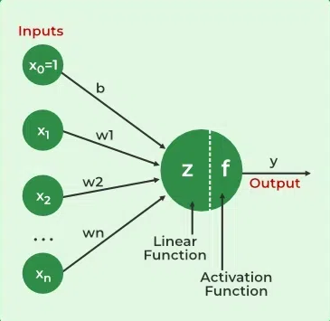
Cont…
In an learning environment:
The neural network is exposed to a simulated scenario or dataset.
Parameters such as weights and biases are updated in response to new data or conditions.
With each adjustment, the network’s response evolves allowing it to adapt effectively to different tasks or environments.

Slide 14
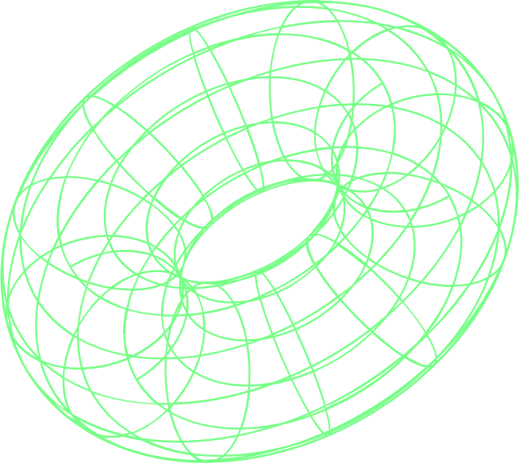
Types of Neural Networks
There are seven types of neural networks that can be used.
Feedforward Networks: It is a simple artificial neural network architecture in which data moves from input to output in a single direction.
Singlelayer Perceptron: It has one layer and it applies weights, sums inputs and uses activation to produce output.
Multilayer Perceptron (MLP): It is a type of feedforward neural network with three or more layers, including an input layer, one or more hidden layers and an output layer. It uses nonlinear activation functions.
Convolutional Neural Network (CNN): It is designed for image processing. It uses convolutional layers to automatically learn features from input images, enabling effective image recognition and classification.
Recurrent Neural Network (RNN): Handles sequential data using feedback loops to retain context over time.
Long Short-Term Memory (LSTM): A type of RNN with memory cells and gates to handle long-term dependencies and avoid vanishing gradients.

Slide 15
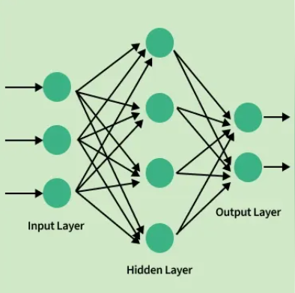
1. Feedforward Networks:
Feedforward Neural Network (FNN) is a type of artificial neural network in which information flows in a single direction i.e from the input layer through hidden layers to the output layer without loops or feedback.

Slide 16
Structure of Feedforward Networks:
Feedforward Neural Networks have a structured layered design where data flows sequentially through each layer.
Input Layer: The input layer consists of neurons that receive the input data. Each neuron in the input layer represents a feature of the input data.
Hidden Layers: One or more hidden layers are placed between the input and output layers. These layers are responsible for learning the complex patterns in the data. Each neuron in a hidden layer applies a weighted sum of inputs followed by a non-linear activation function.
Output Layer: The output layer provides the final output of the network. The number of neurons in this layer corresponds to the number of classes in a classification problem or the number of outputs in a regression problem.
Each connection between neurons in these layers has an associated weight that is adjusted during the training process to minimize the error in predictions.

Slide 17
2. Single Layer Perceptron
Single Layer Perceptron is inspired by biological neurons and their ability to process information. To understand the SLP we first need to break down the workings of a single artificial neuron which is the fundamental building block of neural networks. An artificial neuron is a simplified computational model that mimics the behavior of a biological neuron. It takes inputs, processes them and produces an output. Here's how it works step by step:
Receive signal from outside.
Process the signal and decide whether we need to send information or not.
Communicate the signal to the target cell, which can be another neuron or gland.

Slide 18
Limitations Of Neural Networks
Overfitting: Neural networks can memorize the training data instead of generalizing, leading to poor performance on new data.
Data Scarcity: Many applications lack the large, labeled datasets required for training neural networks effectively.
Computational Costs: Training large neural networks can be prohibitively expensive, requiring specialized hardware like GPUs and TPUs.
Bias and Fairness: Neural networks can inherit biases from the training data, leading to unfair or discriminatory outcomes.

Slide 19
Future of neural network limitations
Predictions for Neural Network Development
Improved Interpretability: Advances in explainable AI will make neural networks more transparent and trustworthy.
Scalable Architectures: New architectures will enable neural networks to scale more efficiently, handling larger datasets and more complex tasks.
Integration with Emerging Technologies: Neural networks will increasingly be integrated with technologies like IoT and blockchain, expanding their applications.

Slide 20
Conclusion
To conclude, we've seen that neural networks are computing systems inspired by the human brain. Their power comes from their structure of interconnected layers that can learn increasingly complex features from data.
They aren't magic—they require large amounts of data and significant computing power to train. However, once trained, they are incredibly effective at tasks like classification, prediction, and recognition.

Slide 21
REFERENCES
IBM. (n.d.). What are convolutional neural networks? IBM. Retrieved October 26, 2023, from https://www.ibm.com/think/topics/convolutional-neural-networks
GeeksforGeeks. (n.d.). Neural Networks: A beginner’s guide. Retrieved October 26, 2023, from https://www.geeksforgeeks.org/machine-learning/neural-networks-a-beginners-guide/
Elsevier B.V. (n.d.). Neural Networks. ScienceDirect. Retrieved October 26, 2023, from https://www.sciencedirect.com/journal/neural-networks
Amazon Web Services, Inc. (n.d.). What is a Neural Network? AWS. Retrieved October 26, 2023, from https://aws.amazon.com/what-is/neural-network/
DataCamp. (n.d.). What are Neural Networks? Retrieved October 26, 2023, from https://www.datacamp.com/blog/what-are-neural-networks

